Slide 1

Nations Data Requests User Manual
Access the portal through https://bit.ly/TheNewDataOps
Works best on a PC; limited functionality on mobile.

Slide 2

Click on Data Requests.
Click on Nations Data Requests.
You will be directed to a portal that asks for your login credentials.

Slide 3
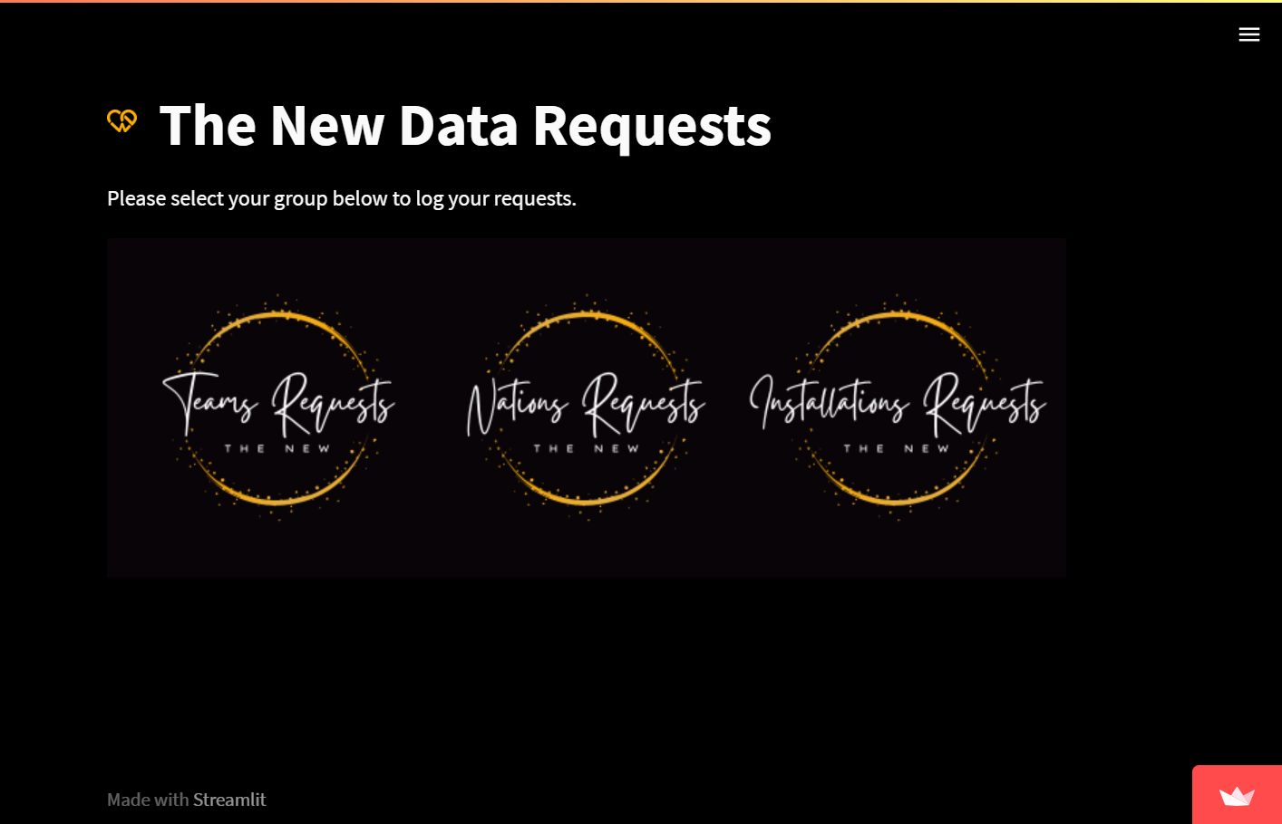
Click on Data Requests.
Click on Nations Data Requests.
You will be directed to a portal that asks for your login credentials.

Slide 4
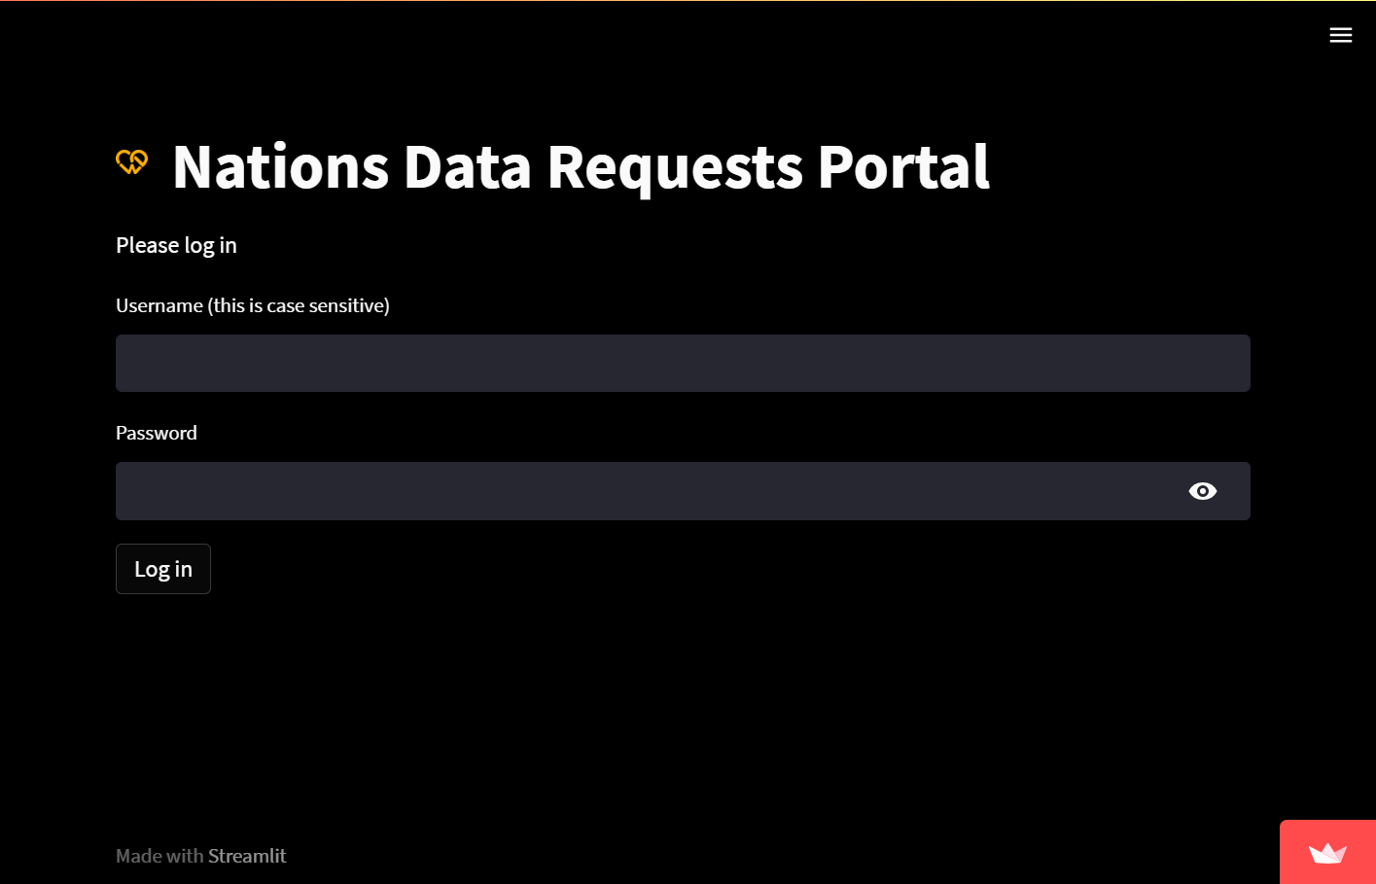
Click on Data Requests.
Click on Nations Data Requests.
You will be directed to a portal that asks for your login credentials.

Slide 5
Add to nations / Modify existing nations

Slide 6
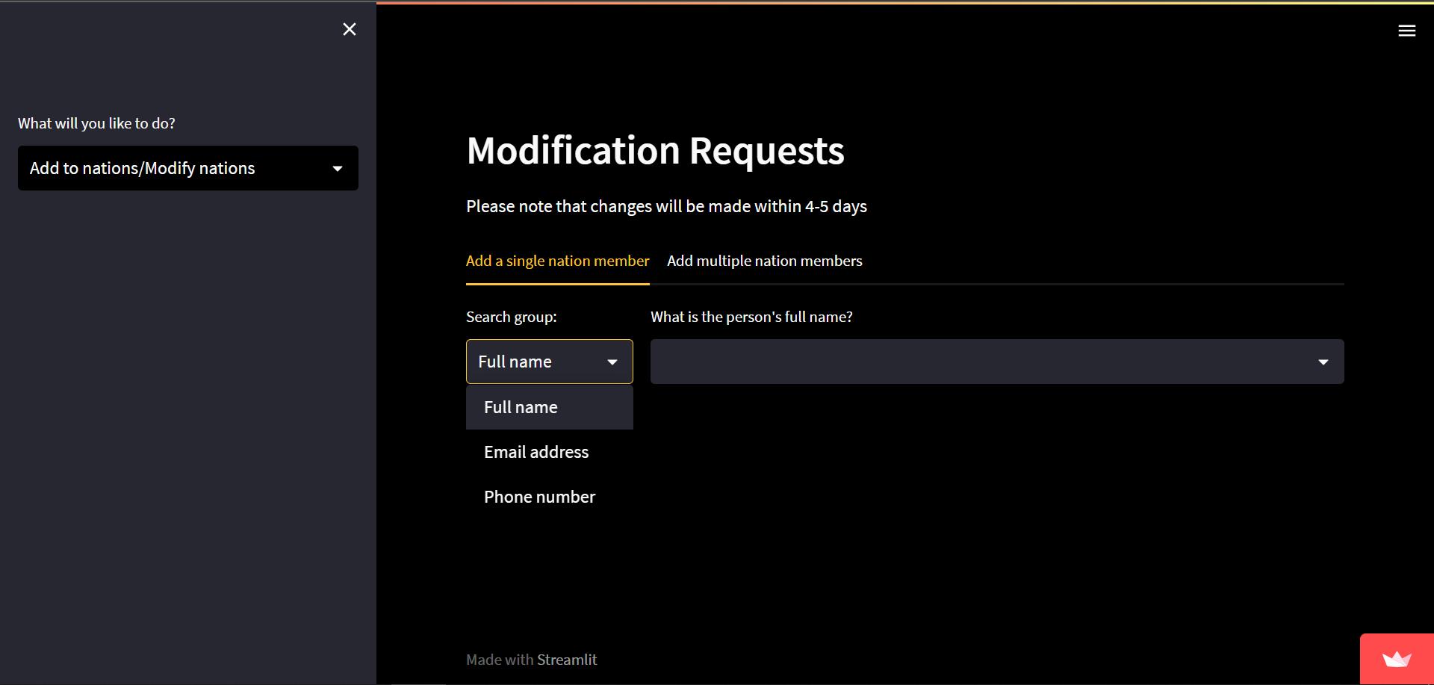
You can either add/modify a single person or multiple people
In the add a single nation member tab, you can search for the person by name, email, or phone number.
Tab Options:
Add to nations/ Modify…
Search for person and select
Search by

Slide 7
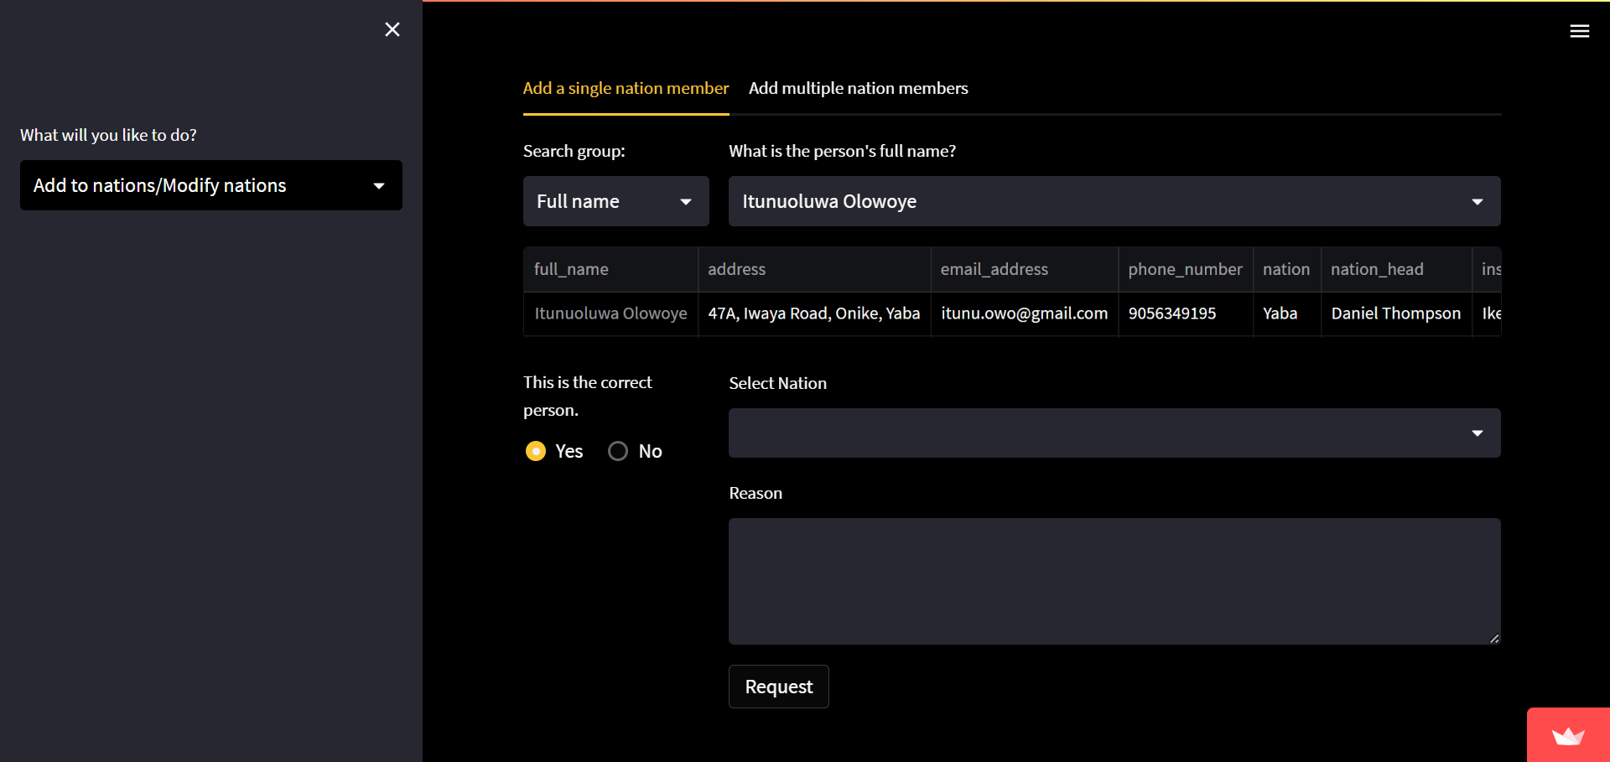
When the person’s record is found and confirmed accurate, select the person’s new nation.
Also write the reason for addition/modification (optional, but preferable).
Click on Request. You should get a confirmatory email for follow up.
Tab Options:
Add to nations/ Modify…
Person’s details
Select new nation and state the reason for addition (optional, but preferable)
Is the record correct?
Log request

Slide 8
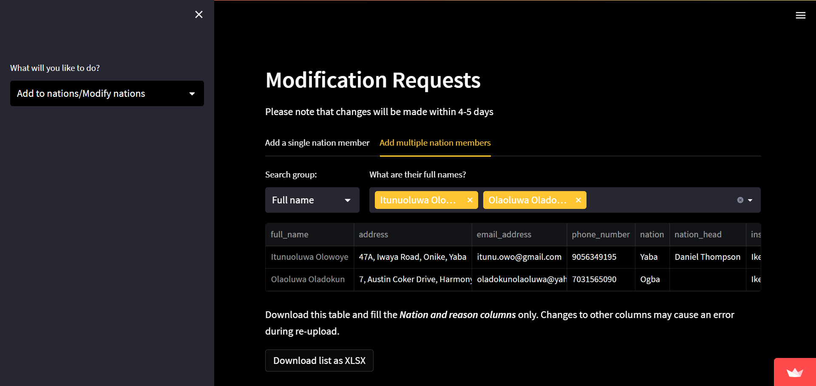
In the add multiple nation members tab, you can search for the people by name, email, or phone number.
When the records are found and confirmed accurate, download the records.
Fill only the nation and reason columns.
The reason for addition/modification is optional, but preferable.
Tab Options:
Add to nations/ Modify…
People’s details
Download file

Slide 9
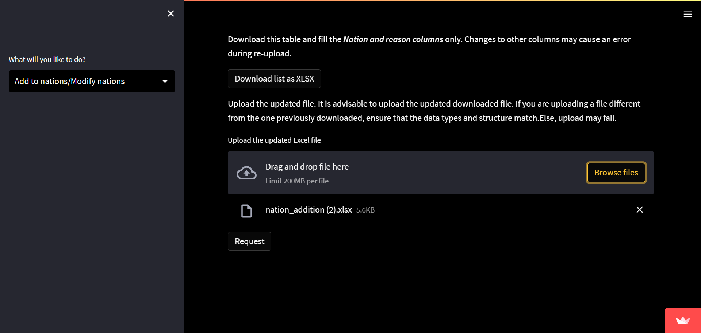
Upload the updated downloaded file.
Send in the request.
You should receive a confirmatory email for follow up
Tab Options:
Add to nations/ Modify…
Send the request
Upload updated downloaded file

Slide 10
Remove from nations

Slide 11

You can either remove a single person or multiple people
In the remove a single nation member tab, you can search for the person by name, email, or phone number.
Tab Options:
Remove from nations
Search for person and select
Search by

Slide 12
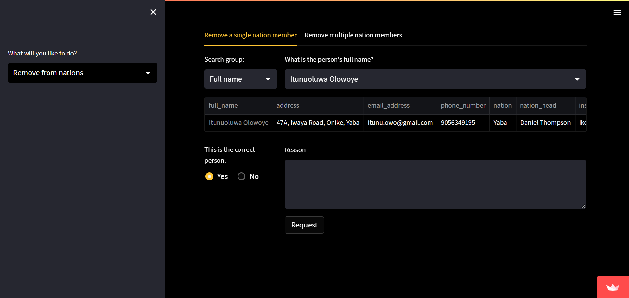
In the remove a single nation member tab, you can search for the person by name, email, or phone number.
When the person’s record is found and confirmed accurate, state the reason for removal (optional, but preferable).
Click on Request. You should get a confirmatory email for follow up.
Tab Options:
Remove from nations
Person’s details
Is the record correct?
State the reason for addition (optional, but preferable)
Log request

Slide 13

In the remove multiple nation members tab, you can search for the people by name, email, or phone number.
When the records are found and confirmed accurate, download the records.
Fill the reason column. Clearing out the nation column is optional.
The reason for removal is optional, but preferable.
Tab Options:
Remove from nations
People’s details
Download file

Slide 14
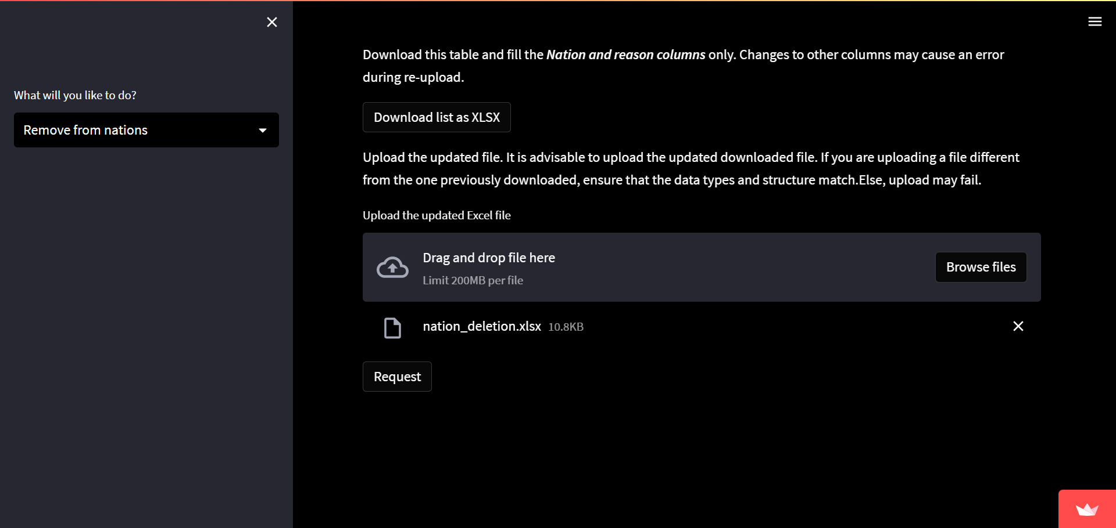
Upload the updated downloaded file.
Send in the request.
You should receive a confirmatory email for follow up
Tab Options:
Remove from nations
Send the request
Upload updated downloaded file

Slide 15
Assign people to nation heads

Slide 16
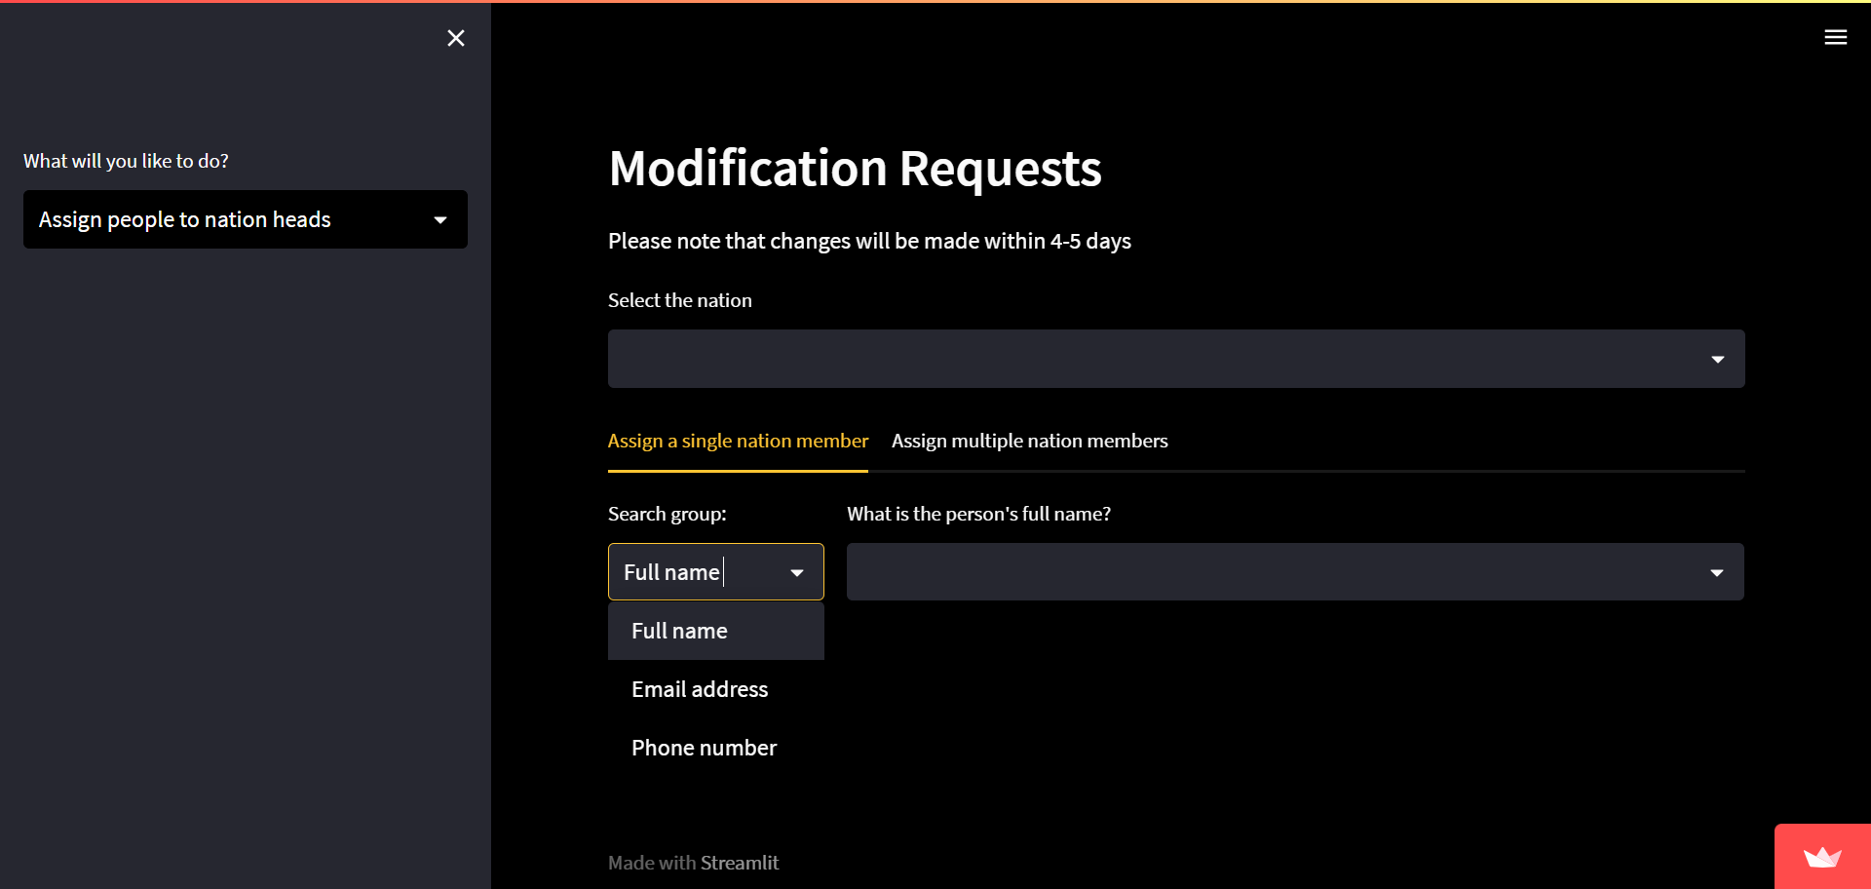
Select the nation you want to assign nation heads to
You can either assign a single person or multiple people
In the assign people to nation heads tab, you can search for the person by name, email, or phone number.
Tab Options:
Assign people to nation heads
Search for nation
Search for person and select
Search by

Slide 17

In the assign a single nation member tab, you can search for the person by name, email, or phone number.
When the person’s record is found and confirmed accurate, select the person’s new nation head.
Also write the reason for assignment(optional, but preferable).
Click on Request. You should get a confirmatory email for follow up.
Tab Options:
Assign people to nation heads
Person’s details
Select new nation and state the reason for addition (optional, but preferable)
Is the record correct?
Log request

Slide 18
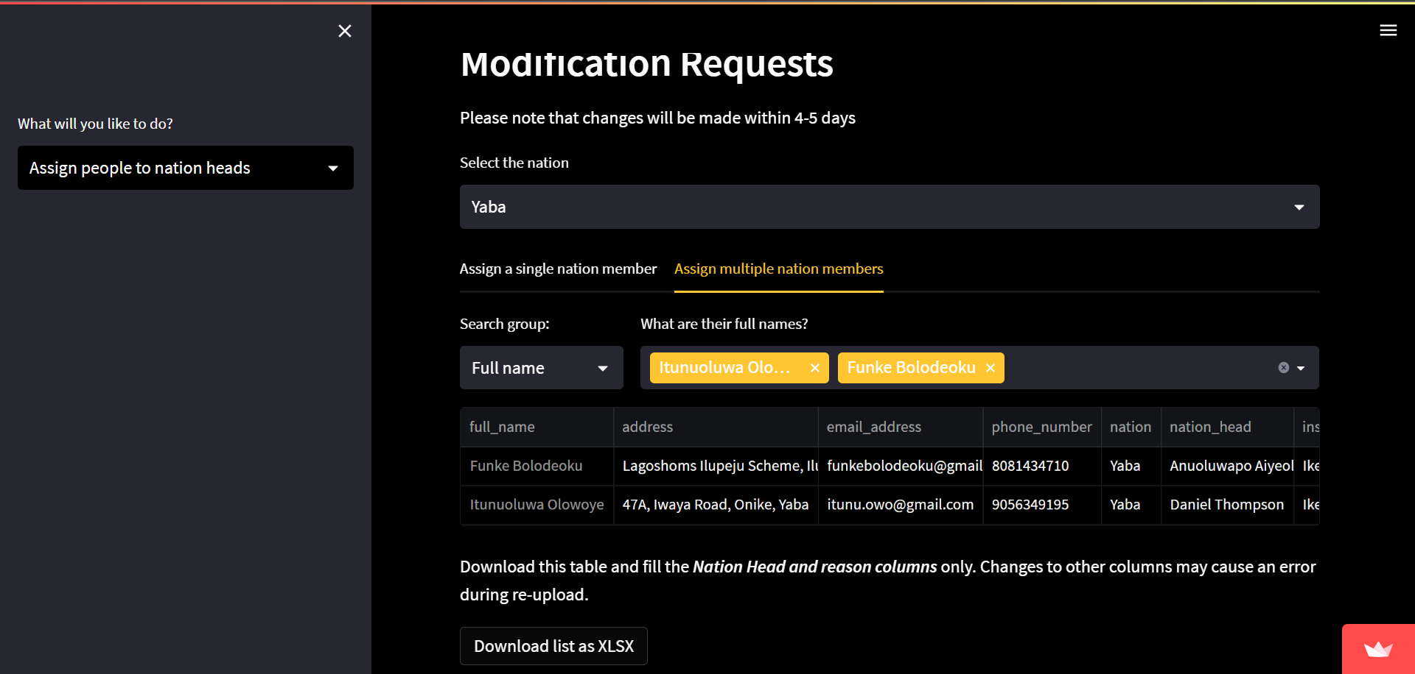
In the assign multiple nation members tab, you can search for the people by name, email, or phone number.
When the records are found and confirmed accurate, download the records.
Fill only the nation head and reason columns.
The reason for assignment is optional, but preferable.
Tab Options:
Assign people to nation heads
People’s details
Download file

Slide 19
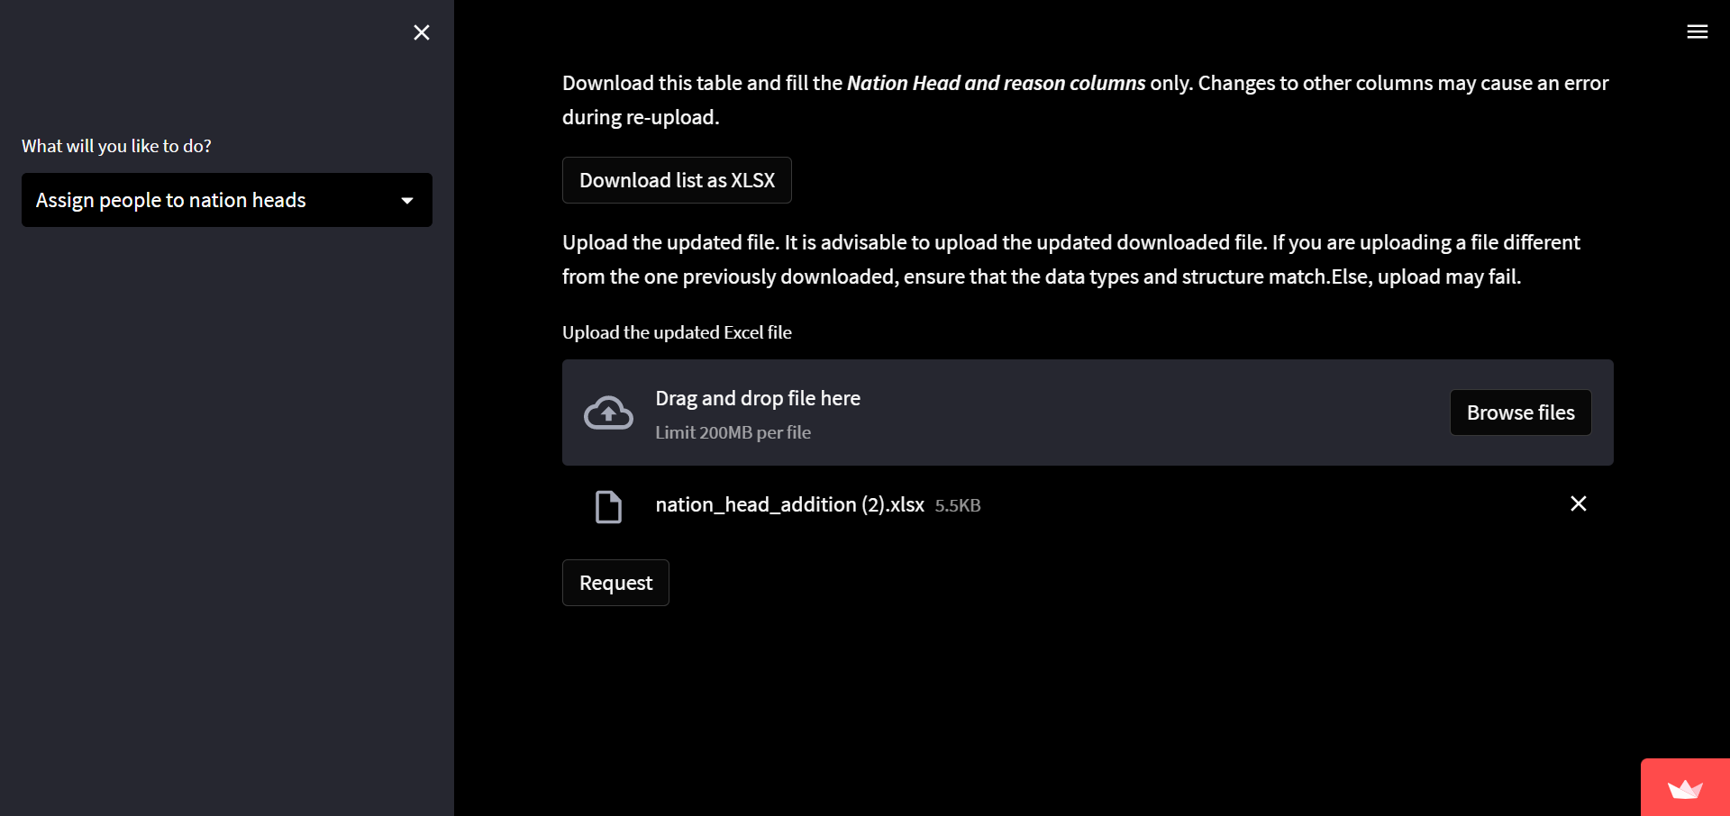
Upload the updated downloaded file.
Send in the request.
You should receive a confirmatory email for follow up
Tab Options:
Assign people to nation heads
Send the request
Upload updated downloaded file

Slide 20
Change nation head

Slide 21
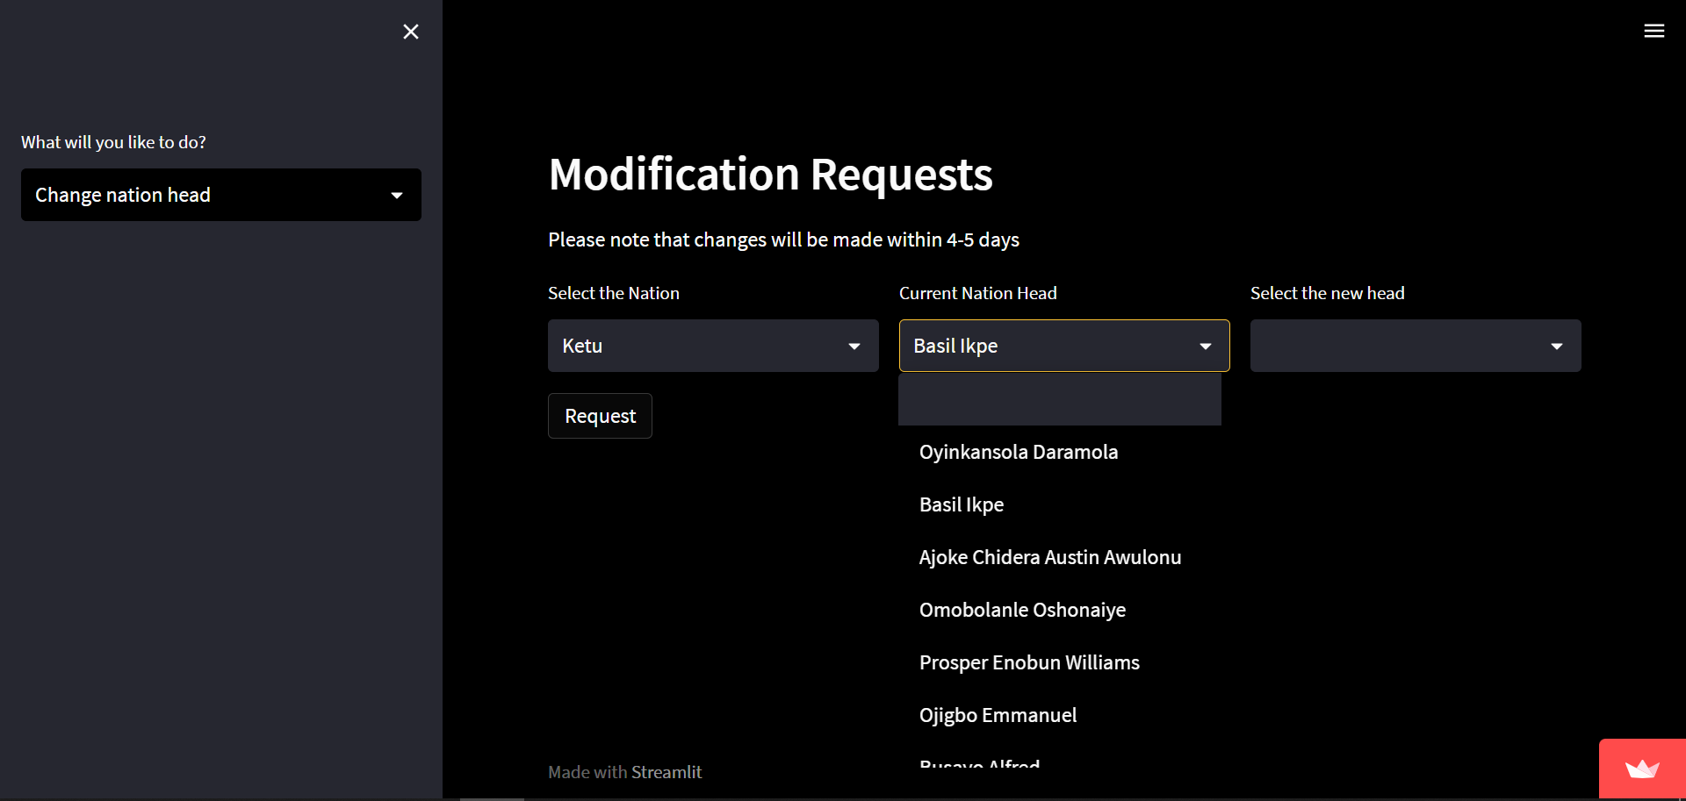
In the case of a handover, you can simply select the nation, select the nation head to change and choose the new nation head.
Click on Request to log your entry.
You should get a confirmation email for follow up.
Tab Options:
Change nation head
Select nation
Send the request
Select new nation head

Slide 22
Thank You

